Slide 1

Finding a Mental Health App that is Right for You with Mindapps.org
Noy Alon

Slide 2

Introduction
Noy Alon is a clinical research assistant at the Digital Psychiatry Lab at Beth Israel Deaconess Medical Center. She leads the team's app evaluation efforts and is in charge of updating the largest database of mental health applications, known as the M-health Index and Navigation Database (MIND). She graduated from Brown University with a degree in Biology in May 2022.
Noy Alon, BS

Slide 3
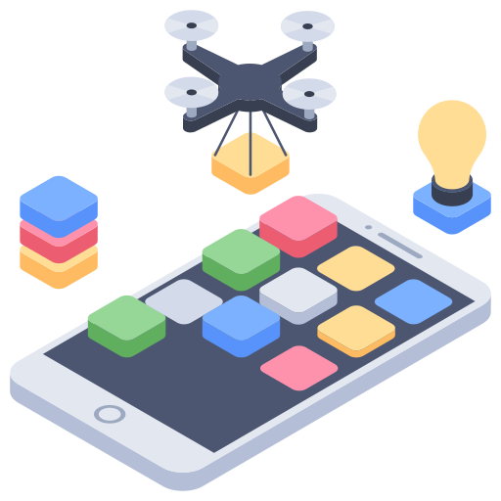
Estimated to be over 10,000 mental health related apps
Torous J, Roberts LW. Needed innovation in digital health and smartphone applications for mental health: transparency and trust. Jama psychiatry. 2017 May 1;74(5):437-8.

Slide 4
Post-Market
Focus of FTC Oversight
Pre-
Market
Pre-Cert Pilot Program
No
Software as a Medical Device?
Yes
Focus of FDA Oversight
Wellness Apps
Enforcement Discretion
”Substantial Equivalence with an Approved App”?
Yes
No
510 (k) Submission
De Novo Pathway
Kahane, Francoius, Torous. The Digital Health App Policy Landscape: Regulatory Gaps and Choices Through the Lens of Mental Health. The Journal of Mental Health Policy and Economics Volume 24, Issue 3, 2021.

Slide 5
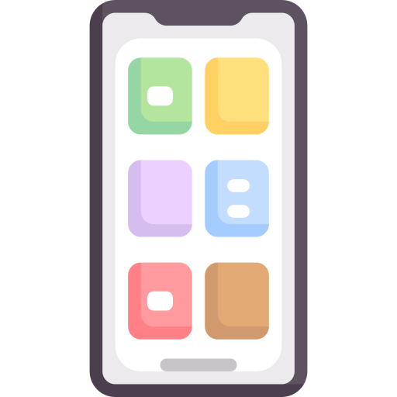


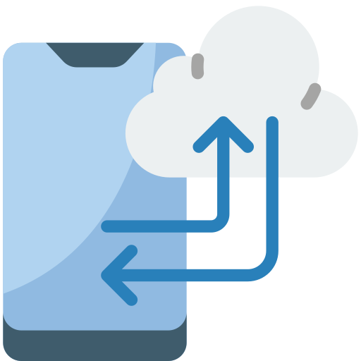
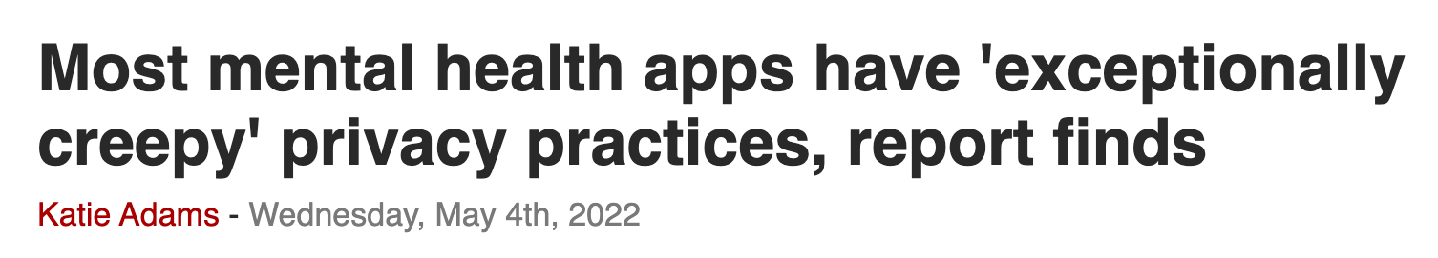
Concern 1: Privacy and Ethics in Digital Health
Tangari G, Ikram M, Ijaz K, Kaafar MA, Berkovsky S. Mobile health and privacy: cross sectional study. bmj. 2021 Jun 17;373.
20,991 mHealth apps
88.0% included code that could potentially collect user data.
3.9% transmitted user information in their traffic.
28.1% provided no privacy policies
47.0% of user data transmissions complied with the privacy policy

Slide 6
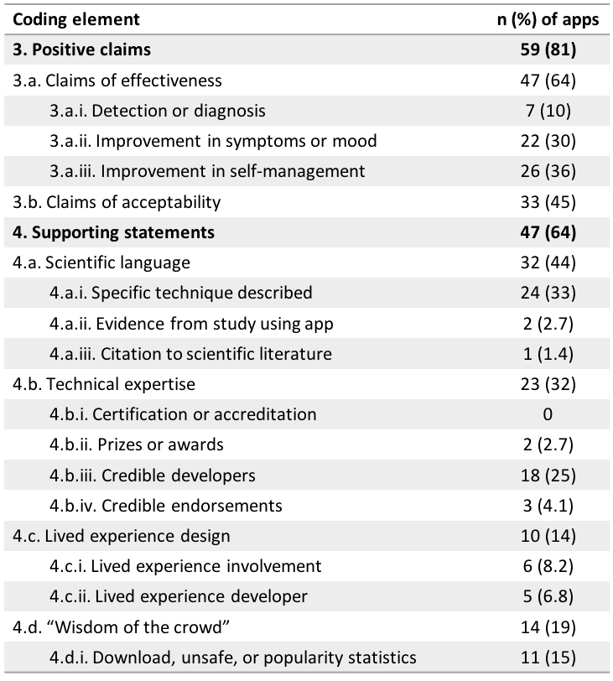

Concern 2:
Lack of an Evidence Base
Although 59 apps claimed to be effective at diagnosing a mental health condition or improving symptoms, only one app included a citation to published literature.

Slide 7
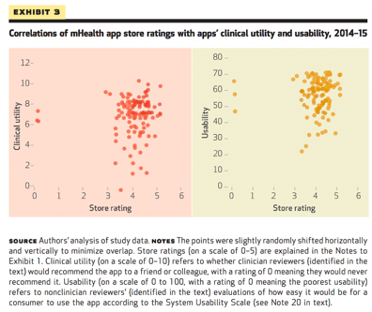
Concern 3: Stars and Download Metrics Can Be Misleading
K Singh et al. Many Mobile Health Apps Target High-Need, High-Cost Populations, But Gaps Remain. Health Affairs. 2016
Notes:
Stars correlate to nothing—a huge finding!!! Sure it’s from 2016, but still relevant. Metrics about download number also tell you nothing. Even apps with 10,000+ downloads had suuuuuper low engagement. Download number is misleading.

Slide 8
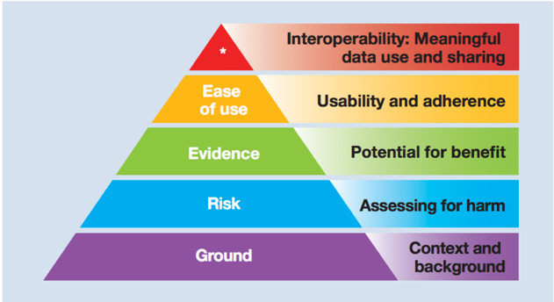
American Psychiatric Association App Evaluation Framework
https://www.psychiatry.org/psychiatrists/practice/mental-health-apps/app-evaluation-model

Slide 9

Integration in TGH Curriculum
On which platforms/operating systems does the app work?
Has the app been updated in the last 180 days?
Is there a transparent privacy policy that is clear and accessible before use?
Does the app collect, us, and/or transmit sensitive data? If yes, does it claim to do so securely?
Is there evidence of specific benefit from academic institutions, end user feedback, or research studies?
Does the app have a clinical/recovery foundation relevant to your intended use?
Does the app seem easy to use?
Can data be easily shared and interpreted in a way that's consistent with the stated purpose of the app?
https://www.psychiatry.org/psychiatrists/practice/mental-health-apps/app-evaluation-model

Slide 10
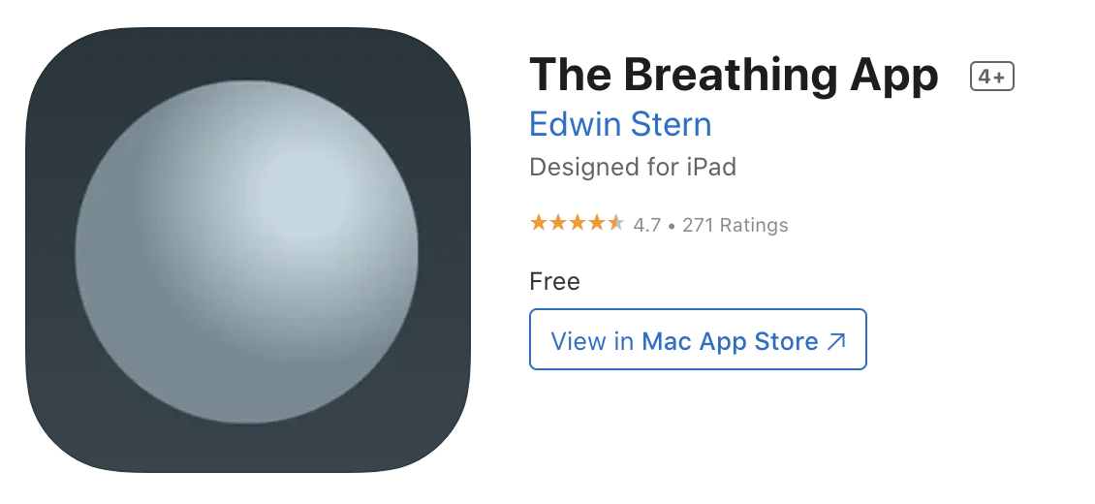
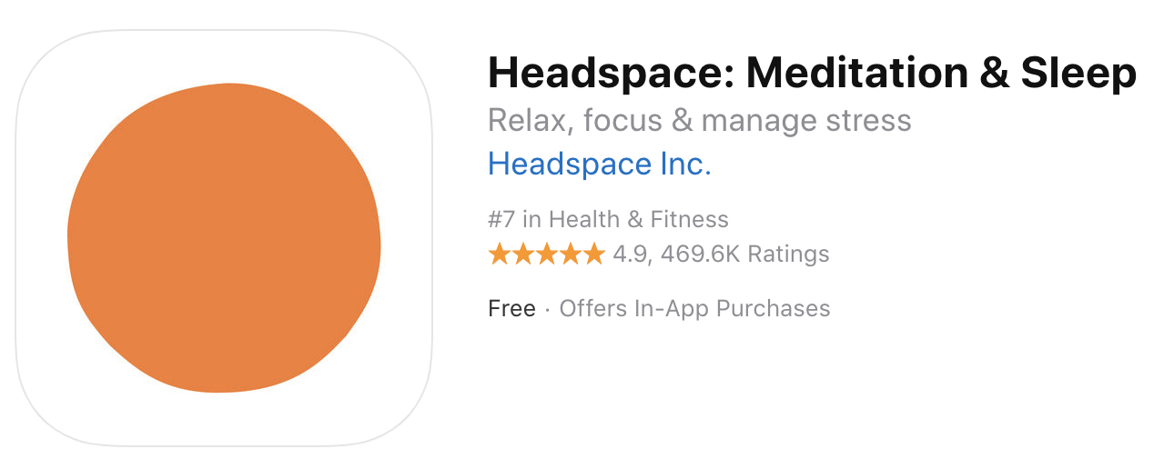
Practice Activity
1. Can you easily find a privacy statement?
2. Do you trust the person who made it?
3. Was the app updated within the past
6 months?
4. Is the app recommended by someone
you trust (doctor, family, friend)?
1. Can you easily find a privacy statement?
2. Do you trust the person who made it?
3. Was the app updated within the past
6 months?
4. Is the app recommended by someone
you trust (doctor, family, friend)?
Yes | No
Yes | No
Yes | No
Yes | No
Yes | No
Yes | No
Yes | No
Yes | No
Notes:
Privacy policy
Trusted developer
Update frequency
Recommendations / Ratings

Slide 11




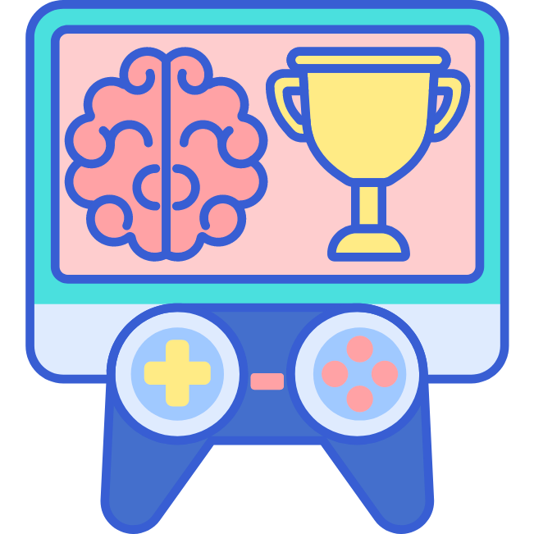

100+ Objective Questions
The questions are aligned with the levels of the APA pyramid but are designed for you to pick which matter when and where
Origin and Functionality
Privacy and Security
Inputs and Outputs
Clinical Foundation
Engagement Style
Interoperability and Sharing

Slide 12
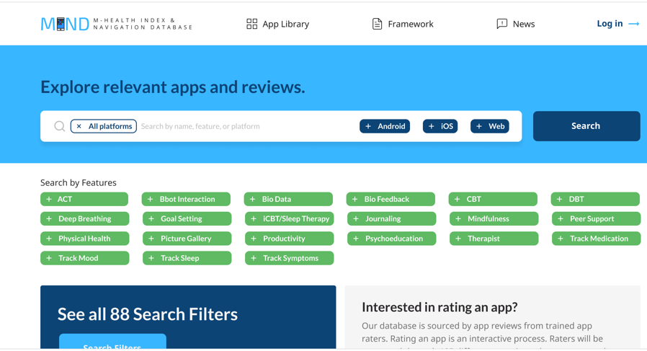
Mindapps.org
On the homepage of the database, the user can filter mental health apps according to what characteristics matter to them: Cost? Privacy settings? Available features? YOU decide.

Slide 13
Integration in TGH Curriculum
If a learner wants to find a health app/resource, instructor can use the same criteria or APA questions
Demonstrate a free resource and framework to make informed decisions online
If a learner wants to find a mental health app/resource, instructor can lead them through the MINDapps website

Slide 14
Find an app to recommend to this client.
Your client is a Spanish speaker that is looking for an app available in her native language. She suffers from anxiety. She doesn't think there is an app out there for her because she shares an apartment with several people so the Wifi is not usually that strong. You inform her that there are apps that function offline and you can help her find one for her. She is only willing to download an app that is totally free.
Case Scenario
Notes:
Virtual Hope Box
Spanish
Anxiety
Offline
Totally free
Deeping breathing
Studies
Productivity

Slide 15
Find an app to recommend to this client.
Your client is a Spanish speaker that is looking for an app available in her native language. She suffers from anxiety. She doesn't think there is an app out there for her because she shares an apartment with several people so the Wifi is not usually that strong. You inform her that there are apps that function offline and you can help her find one for her. She is only willing to download an app that is totally free.
Case Scenario
Notes:
Virtual Hope Box
Spanish
Anxiety
Offline
Totally free
Deeping breathing
Studies
Productivity

Slide 16
Thank You!
Digitalpsych.org
nalon@bidmc.harvard.edu

